Slide 1


WELCOME
To Our
SOFTWER DEVELOPMENT PROJECT

Slide 2
Overview
Introduction
Program overview
What we used
How to works
Advantage
Develop in future

Slide 3

SMART FARMING MANAGEMENT.
Prepared By:
Abul Hasnat (216)
Afsana Akter(189)
Rokonuzzaman Razu(211)
Section : 5
Intake : 38
Program : B.Sc Engg. in CSE at BUBT

Slide 4
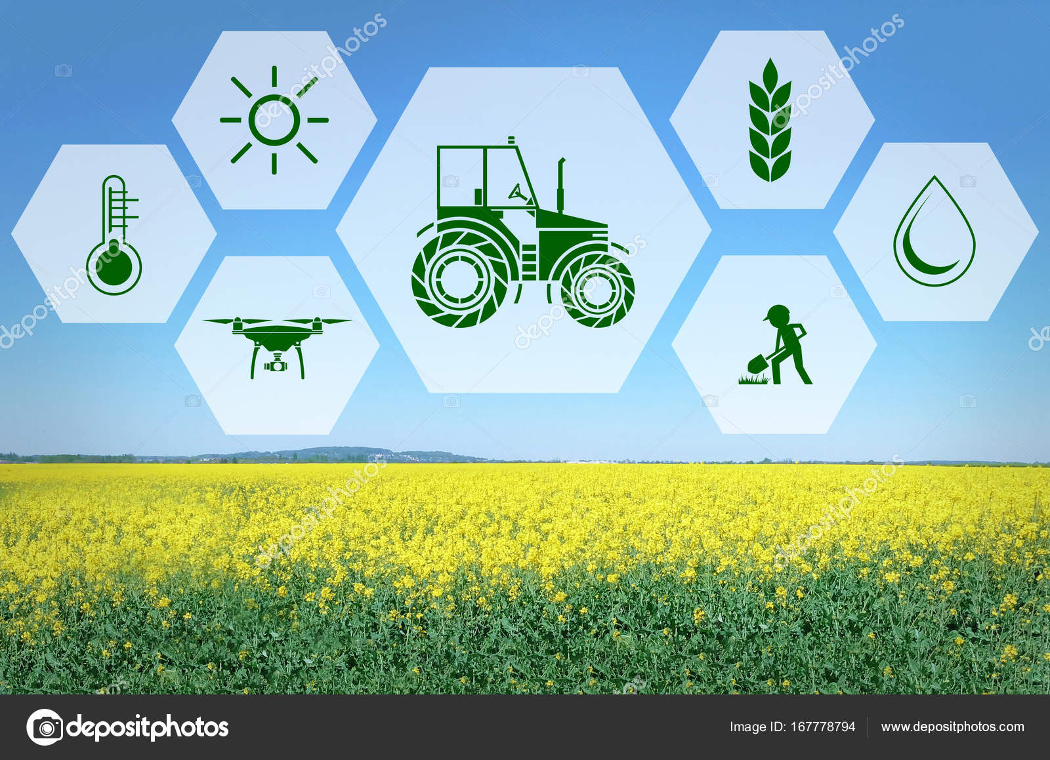
PROGRAM OVERVIEW
Main Function
Password
Main menu
Area
Output
Input
Delete

Slide 5
what we used
We created this project by C programming
User define function
Array
Loop
Switch case & if else
Operator
File

Slide 6
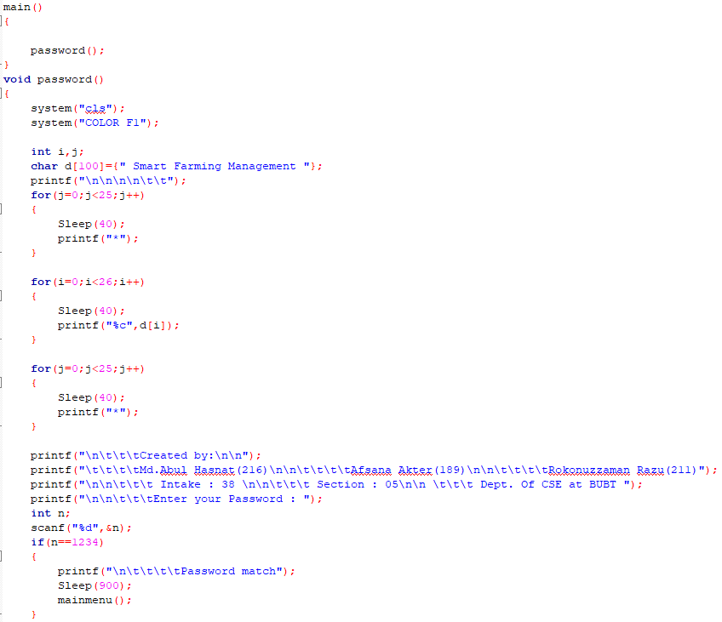
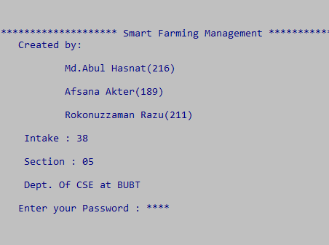
HOW IT WORKS

Slide 7
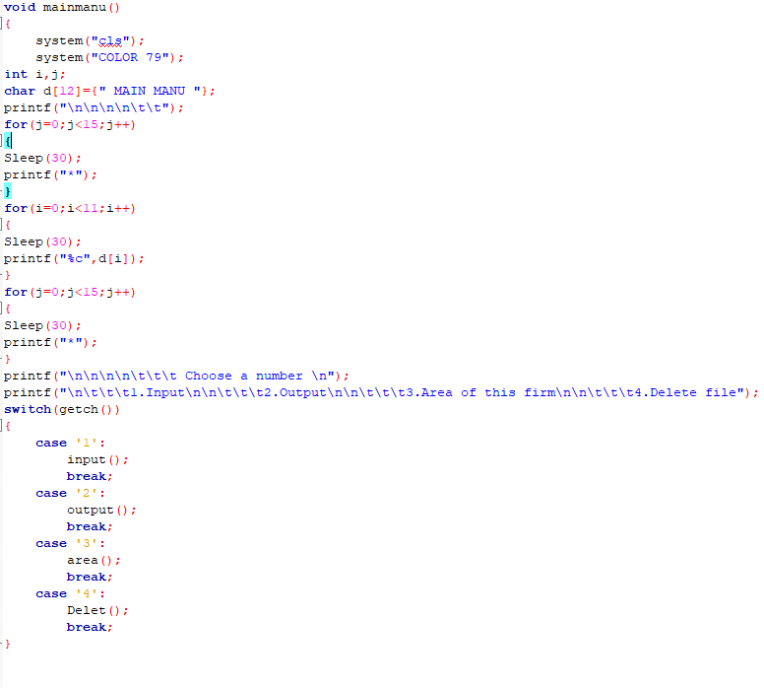
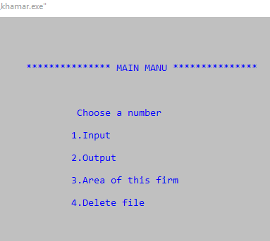
HOW IT WORKS

Slide 8
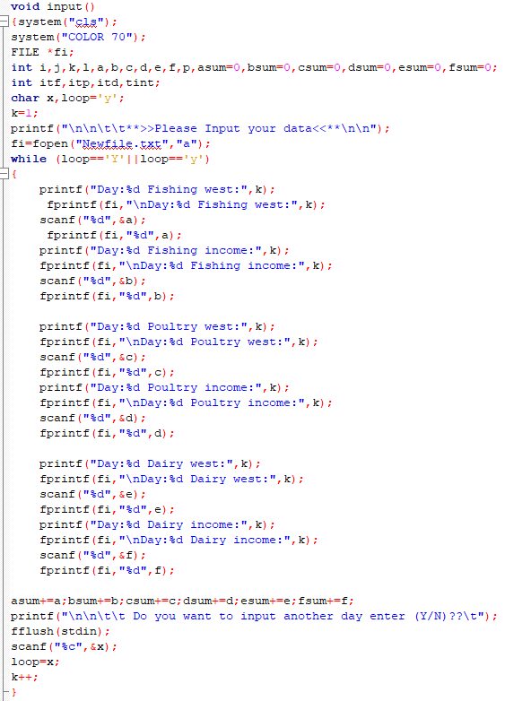
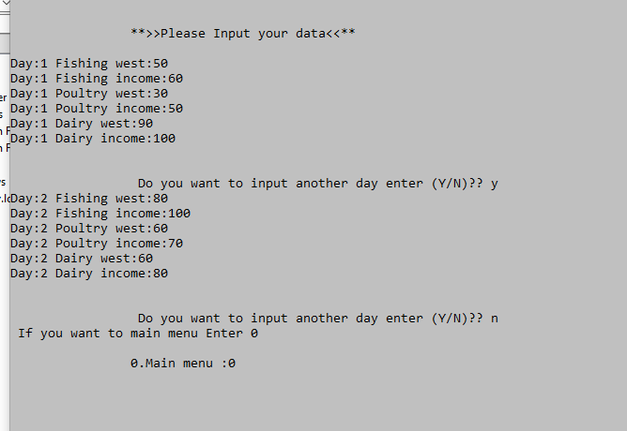
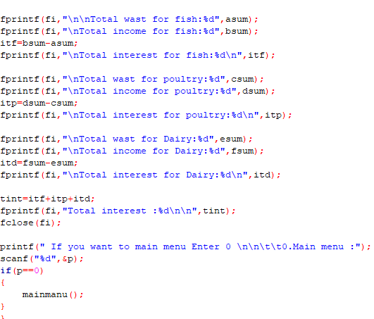
HOW IT WORKS

Slide 9
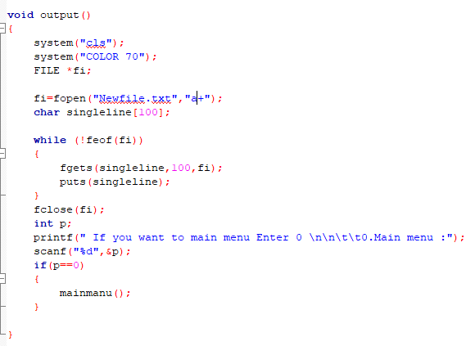
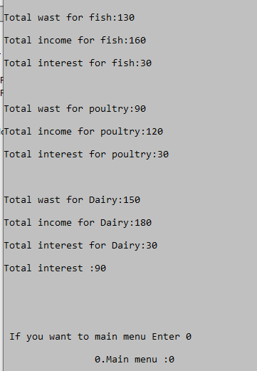
HOW IT WORKS

Slide 10
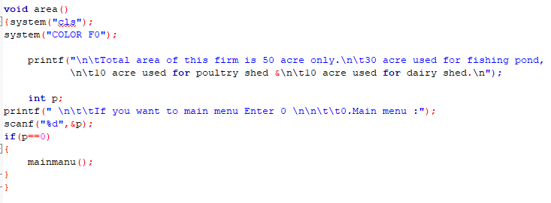
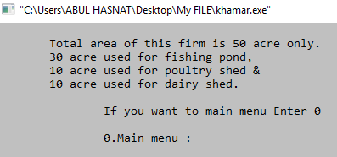
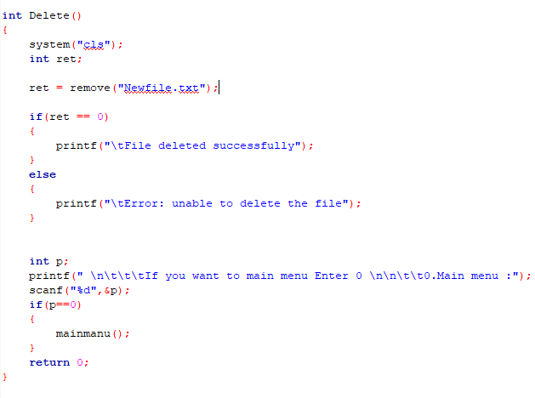
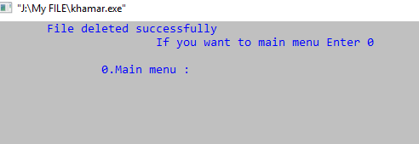
HOW IT WORKS

Slide 11
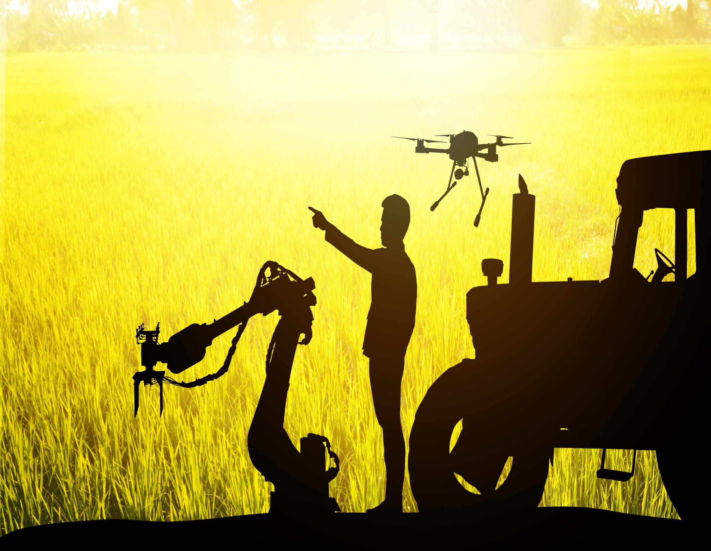
ADVANTAGE
Easy calculation
All in together
Correct calculation
Easily used
Clear concept

Slide 12
DEVELOPED IN FUTURE
1 including health data for animals
2 including current weather data from sensor
3 Show balance data between health & weather
4 including data of lobar force
5 include produce data

Slide 13


Any Question
About
Our Project ?

Slide 14


for your attention

